Slide 1



Thermal Infrared Object Recognition Using YOLOV8 and MGO-CNN for UAV Night Surveillance
Dhruv Dhar, Yashovardhan Pandey and Dr. V. Arulalan
Department of Computing Technologies
SRM Institute of Science and Technology, Kattankulathur

Slide 2
Abstract
Unmanned Aerial Vehicles (UAVs) are used for real-time night surveillance in critical areas like border zones.
The system captures thermal infrared video to operate effectively in low-visibility conditions.
Preprocessing removes thermal noise from frames to enhance input quality.
An image enhancement module improves contrast and visibility of key features.
YOLOv8 performs object localization by detecting bounding boxes in thermal frames.
Localized regions are classified using a CNN optimized via Mountain Gazelle Optimization (MGO).
The hybrid system ensures robust human and vehicle detection in nighttime surveillance environments.

Slide 3
Introduction
Drones equipped with thermal cameras are essential for surveillance in low-light or night-time environments.
Thermal imaging captures heat signatures, allowing object detection even in complete darkness.
Detecting objects from drone-based thermal images is challenging due to low contrast and noise.
Deep learning models like YOLO and CNNs help detect and classify objects in thermal video frames.
This technology is widely used in border security, search and rescue, and critical infrastructure monitoring.

Slide 4
Literature Survey
S. No. | Paper Name | Author(s) | Observation | Limitations
1 | YOLO-based Wide-Area Surveillance System | Mantau et al. | Demonstrated combining deep learning with metaheuristics under low visibility. | Limited focus on real-time constraints; lacks analysis on diverse environmental conditions.
2 | Comparative Analysis of CNN-based Object Detection | Bilous et al. | YOLOv5 had better speed; SSD had better localization but both struggled with overlaps. | Overlapping object issues not fully resolved; results dataset-dependent.
3 | G-YOLO for Remote Sensing and UAV-based Infrared Detection | Zhao et al. | Highlighted limits in standard classifiers; promoted optimization-driven approaches. | Focused on classification only; detection performance not thoroughly benchmarked.
4 | Integration of PCA with Hybrid Metaheuristic Algorithms | Teixeira et al. | Validated nature-inspired algorithms like MGO for improved classification. | PCA may reduce important feature variance; limited evaluation on diverse UAV datasets.

Slide 5
Proposed system
Thermal Video Capture via UAV: UAVs capture real-time thermal infrared video in low-visibility environments.
Preprocessing Stage: Thermal noise is removed to improve frame quality and reduce artifacts.
Image Enhancement: Contrast and visibility of critical features are enhanced for better detection.
Object Detection using YOLOv8: YOLOv8 detects objects and generates bounding boxes in thermal frames.
Region Cropping: Detected object regions are cropped from the frames for classification.
Classification using CNN optimized by MGO: A CNN, optimized via Mountain Gazelle Optimization, classifies the objects accurately.

Slide 6
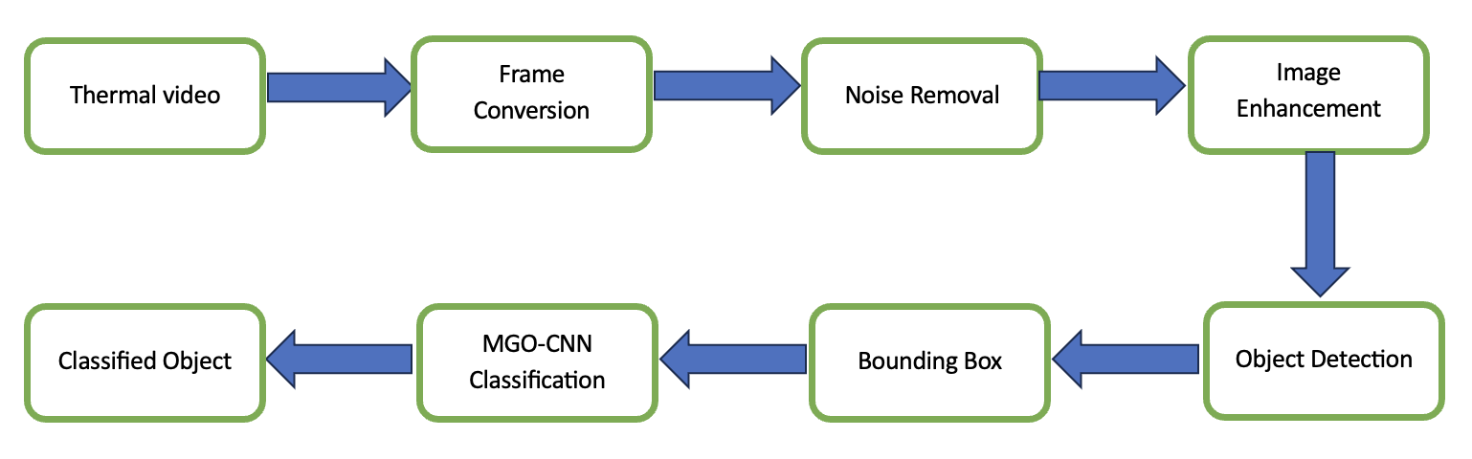
Architecture diagram

Slide 7
YOLOv8 for Object Localization
Input Preprocessing: Takes the input image and resizes it (e.g., 640×640). Normalizes and formats the image for network input.
Feature Extraction (Backbone): Uses a CSPDarknet-based backbone to extract spatial features. Captures both low-level and high-level image details.
Feature Fusion (Neck): Applies FPN and PANet to fuse multi-scale features. Enhances the model’s ability to localize objects of various sizes.
Anchor-Free Detection Head: Predicts bounding box coordinates directly without anchor boxes. Outputs object center (x, y), width (w), and height (h).

Slide 8
YOLOv8 for Object Localization -contd
Bounding Box Regression: Uses CIoU or DIoU loss for accurate box prediction. Minimizes spatial and shape differences from ground truth.
Confidence Scoring: Generates a confidence score for each bounding box. Indicates likelihood of object presence at the predicted location.
Non-Maximum Suppression (NMS): Applies adaptive NMS to remove overlapping boxes. Retains only the most confident and distinct predictions.
Final Output: Returns high-precision bounding boxes for localized objects. Suitable for real-time detection in diverse environments.

Slide 9
Mountain Gazelle Optimization (MGO)
Input Regions from Detection Stage: Cropped object regions from YOLOv8 detection are passed to the CNN for classification.
CNN Architecture Setup: A Convolutional Neural Network (CNN) is built with adjustable layers, filters, and dropout settings.
Parameter Initialization: Initial values for learning rate, filter size, dropout, and layers are randomly generated.
MGO Optimization Begins: Mountain Gazelle Optimization (MGO) initializes a population of candidate CNN configurations.
Fitness Evaluation: Each CNN is trained and evaluated based on classification accuracy to determine fitness.
Gazelle Behavior Simulation: MGO updates parameters by simulating gazelle social behavior, balancing exploration and exploitation.
Best Model Selection: The configuration with the highest classification performance is selected as the final CNN model.
Final Object Classification: The optimized CNN accurately classifies objects (e.g., person, car, truck) from thermal UAV frames.

Slide 10
Results and Discussion
Dataset Used:
HIT-UAV Dataset
Contains thermal images from UAVs across diverse locations.
Classes: Person, Bicycle, Car, Other Vehicle.
Results Summary:
High mAP for object detection using YOLOv8.
Improved classification metrics (accuracy, F1-score) with MGO-CNN.
Average inference time suitable for real-time deployment.

Slide 11
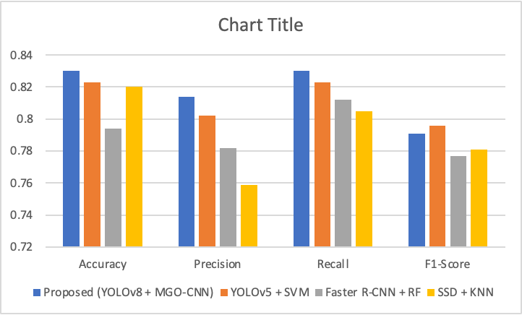
Performance analysis graph

Slide 12
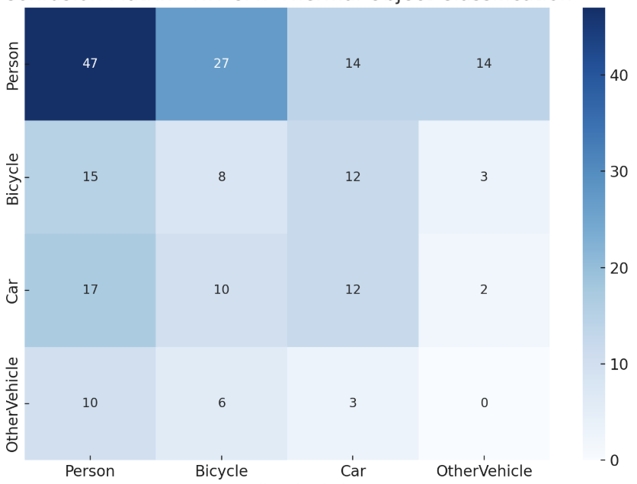
Confusion matrix

Slide 13
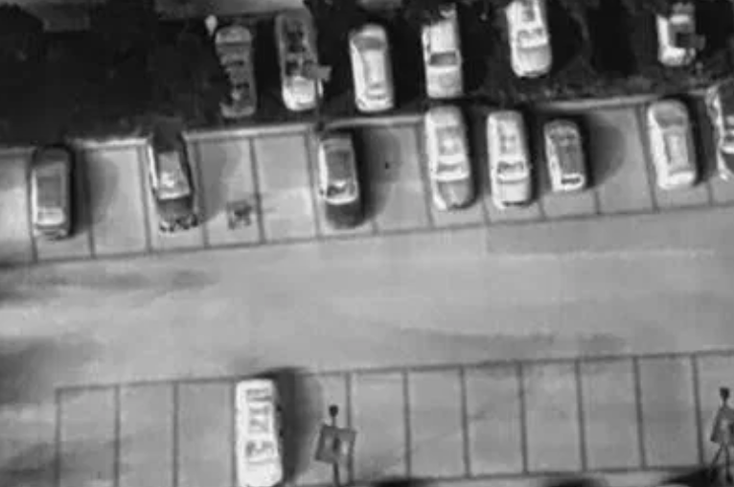
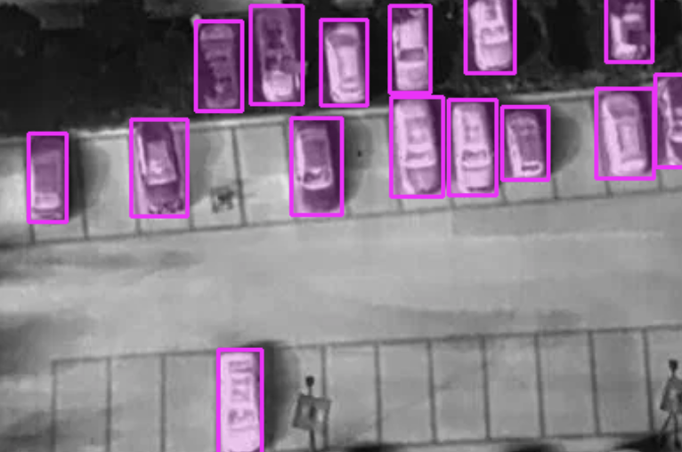
Object detection - CAR
Input thermal image
Detected objects

Slide 14
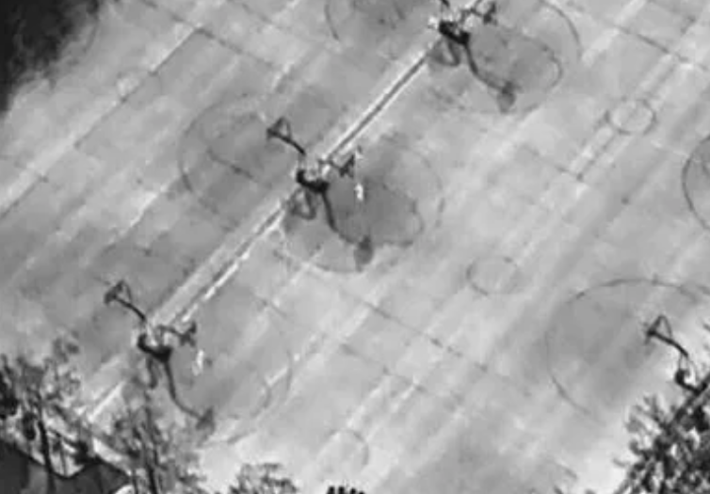
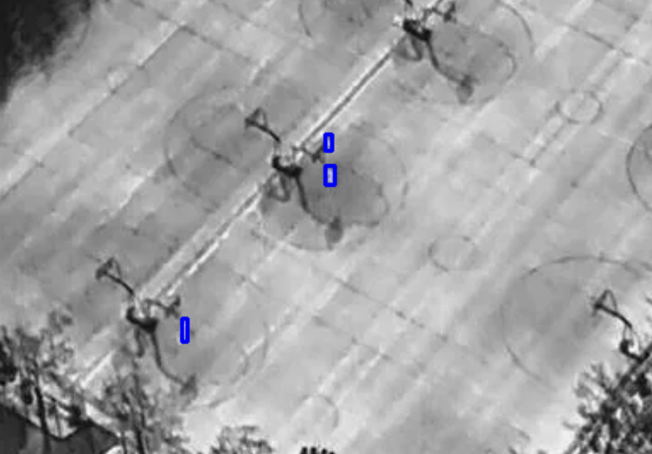
Object detection - Person
Input thermal image
Detected objects

Slide 15
Conclusion & future work
The proposed hybrid framework effectively integrates YOLOv8 for object detection and MGO-CNN for classification, addressing challenges in thermal imagery.
Demonstrated scalability and robustness in real-world surveillance scenarios, particularly night time operations.
Contributions to scalable deployment in security-critical areas.
Extend the framework to multi-class object detection with more complex datasets.
Explore deployment on edge devices for fully autonomous UAV systems.

Slide 16
References
M. R. Ahmed et al., “Survey of UAV Applications in Civilian and Military Domains,” IEEE Access, vol. 8, pp. 179656–179681, 2020.
M. Gade and F. Melgani, “Thermal Image Processing for Remote Sensing,” IEEE Trans. Geosci. Remote Sens., vol. 60, pp. 1–13, 2022.
G. Jocher et al., “YOLO by Ultralytics,” GitHub Repository, 2023.
M. S. Kora and M. Kalva, “Mountain Gazelle Optimization Algorithm for Feature Selection in Biomedical Data,” IEEE Access, vol. 9, pp. 102345–102358, 2021.
A. B. J. Mantau, “Human Observing for Wide Area Surveillance Using Autonomous Unmanned Aerial Vehicles (UAVs),” Kyutech Repository, 2023.
N. Bilous et al., “Comparison of CNN-Based Architectures for Detection of Different Object Classes,” AI, vol. 5, no. 4, pp. 113–130, 2024.
B. Ding, Y. Zhang, and S. Ma, “A Lightweight Real-Time Infrared Object Detection Model Based on YOLOv8 for Unmanned Aerial Vehicles,” Drones, vol. 8, no. 9, 2024.
X. Zhao et al., “G-YOLO: A Lightweight Infrared Aerial Remote Sensing Target Detection Model for UAVs Based on YOLOv8,” Drones, vol. 8, no. 9, 2024.
K. Teixeira, G. Miguel, H. S. Silva, and F. Madeiro, “A Survey on Applications of Unmanned Aerial Vehicles Using Machine Learning,” IEEE Access, vol. 11, pp. 114309–114326, 2023.
M. S. Kora and M. Kalva, “Mountain Gazelle Optimization Algorithm for Feature Selection in Biomedical Data,” IEEE Access, vol. 9, pp. 102345–102358, 2021.
J. Zhang, Z. Guo, H. Liu, Y. Wang, and X. Sun, “HIT-UAV: A High-Altitude Infrared Thermal Dataset for Unmanned Aerial Vehicle-Based Object Detection,” Scientific Data, vol. 10, no. 1, pp. 1–10, 2023.

Slide 17


